Slide 1
Team Smart Diet
For a Healthy Tomorrow

Slide 2
Purpose

Slide 3
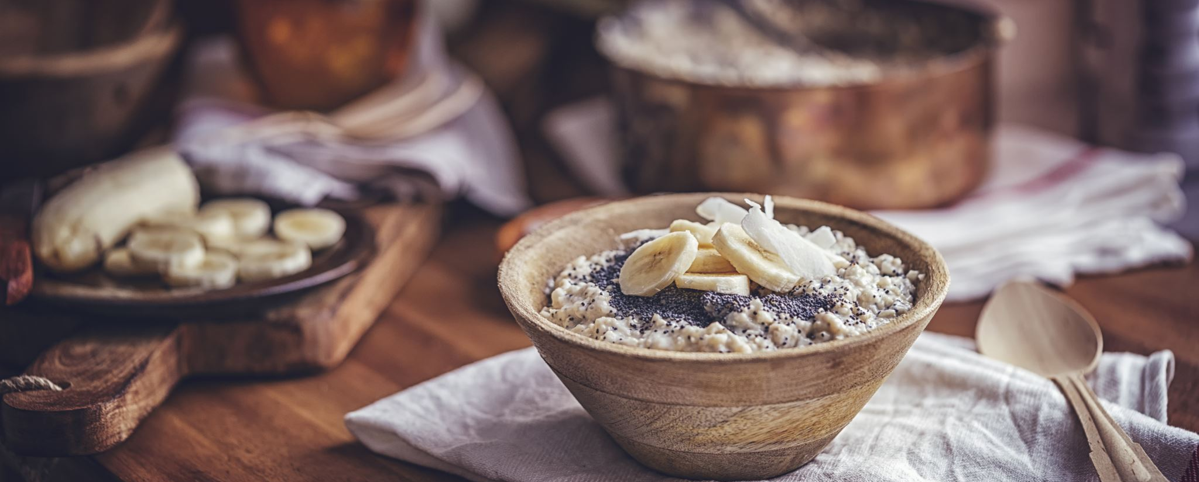
Suggest a Meal
Team: Smart Diet

Slide 4
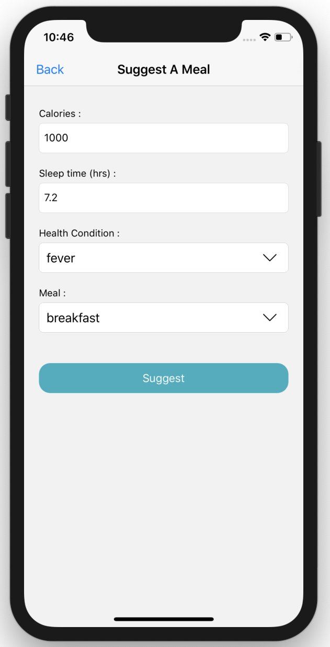
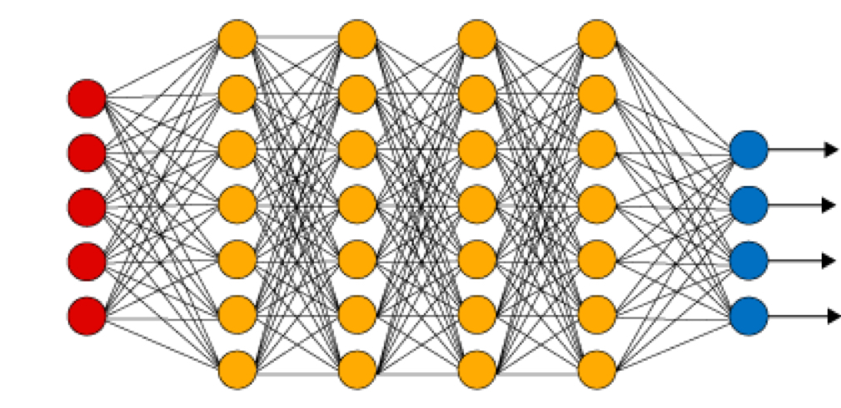
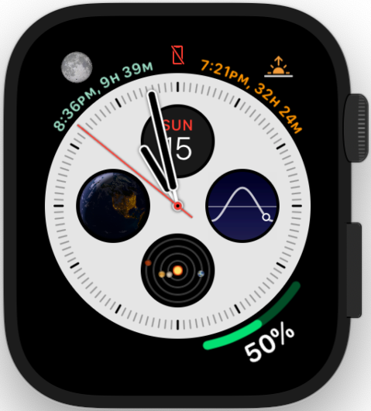
Structure & Demo
Fetches the health data from smart watch / fitness band. We can use ML lite to generate features which will be the input for the server ML.
ML model uses Deep neural network(DNN) to pick the appropriate meal or opt a meal

Slide 5
Q&A

